Slide 1
SCAPv2 and OpenC2
David Kemp, NSA Cybersecurity
SCAPv2 Fall Virtual Workshop
29 Sept 2020

Slide 2
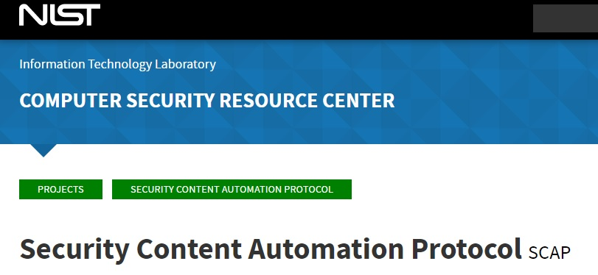
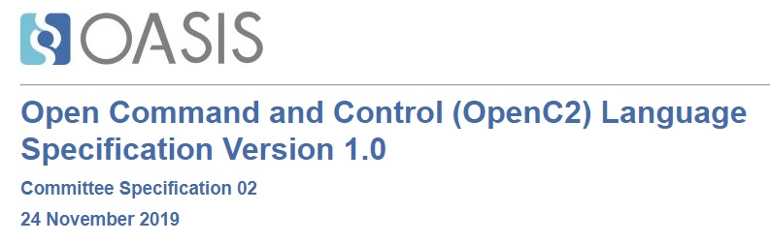
Relationship
SCAP defines assessment data
SCAPv2 includes ongoing assessment operations
OpenC2 protocol communicates assessment requests and results
Development Projects:
SCAPv2 Endpoint Data Collection Prototype
OpenC2 SBOM Proof of Concept

Slide 3
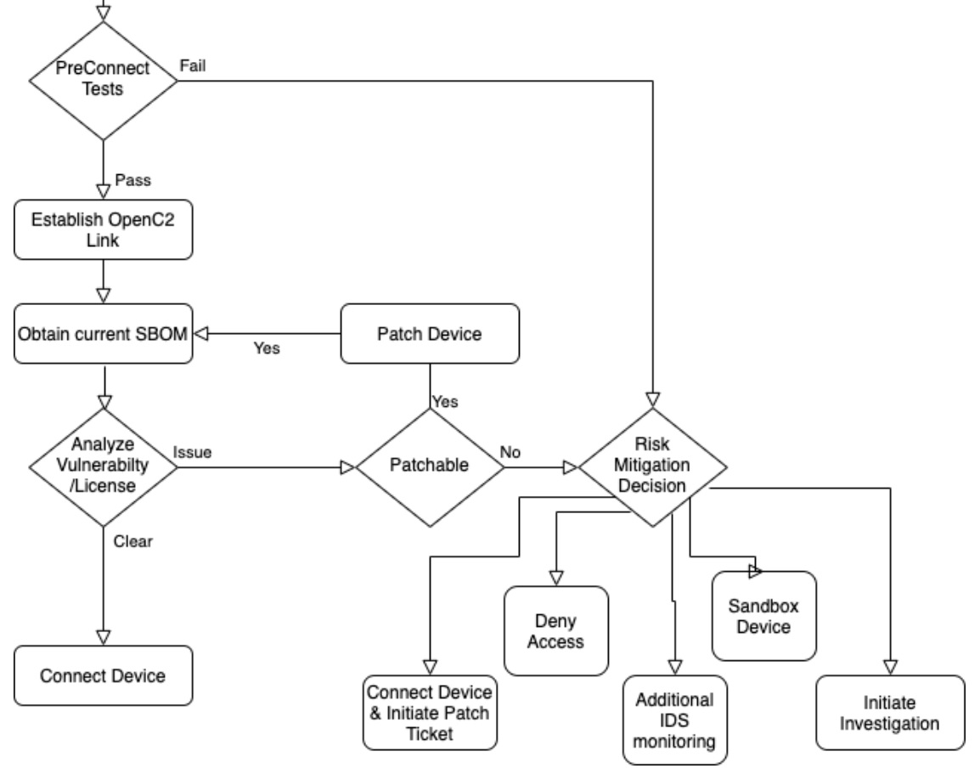
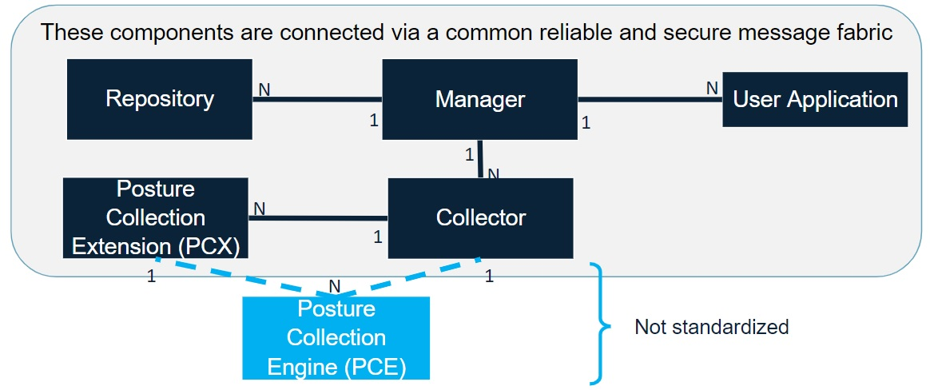
Development Projects
OpenC2 Messaging
SCAPv2 Application
SCAPv2 Data Collection Prototype
OpenC2 Software Bill of Materials Proof of Concept
https://github.com/oasis-tcs/openc2-usecases/tree/master/SBOM-PoC

Slide 4
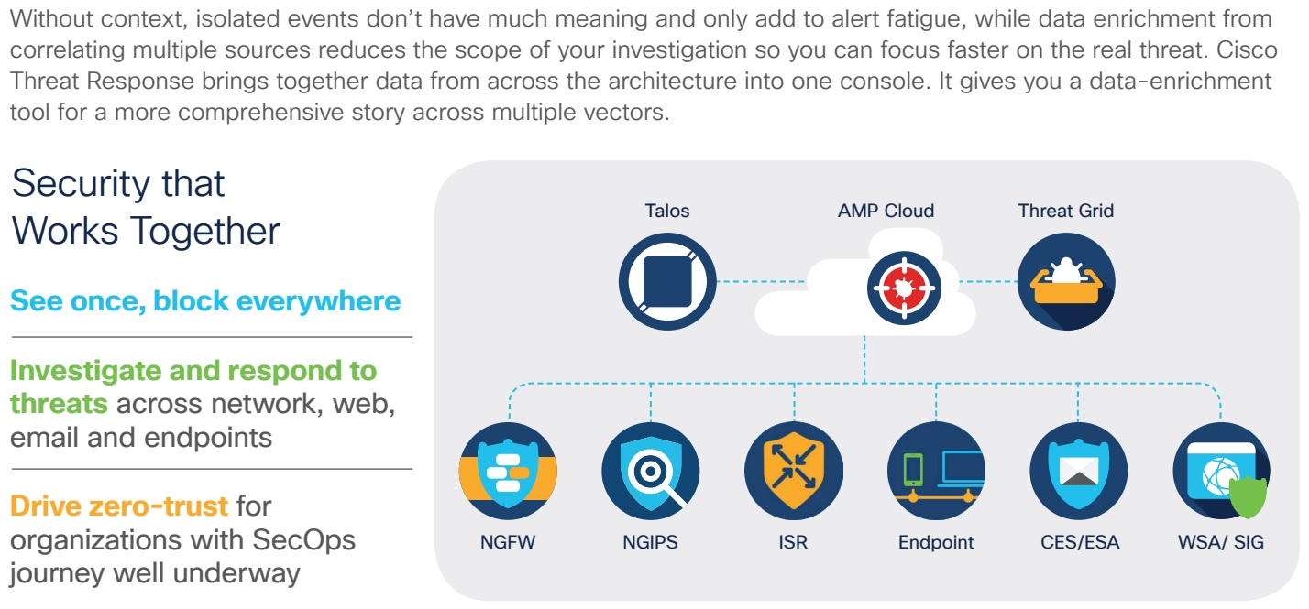
OpenC2 Scope
The Struggle Behind Long Remediation Cycles
A 2018 incident response survey by SANS showed an increase in the number of organizations detecting incidents within 24 hours, along with a general move to shorter detection. However, despite 53% of organizations detecting incidents within 24 hours, 61% took two or more days to remediate.
Remediation Cycle
(OODA Loop):
Sense
Analyze
Decide
Act
OpenC2: vendor-agnostic vocabulary of core and extension commands, integrable into response playbooks.
NETCONF vendor extensions
OpenC2 function extensions
Out of scope
In scope
controls
https://www.cisco.com/c/dam/en/us/products/collateral/security/amp-for-endpoints/amp4e-w-orbital-wp.pdf

Slide 5
What Is OpenC2?
Protocol: http, mqtt, opendxl, …
Headers: carried in Protocol or Message
Payload: Message or Content (as indicated by media-type)
Protocol
{
"request_id": "32cd9168-338f-11e4-0d01-0050569b7
"body": {
"openc2": {
"request":
}
}
}
Content: control structure and cybersecurity vocabulary for discrete actions
Action (verb): allow, deny, contain, scan, query, restart, …
Target (noun): device, file, ip address, ip connection, url, …
Args: additional details: where and how to perform the action
Actuator (function): packet filtering, intrusion prevention, assessment, ...
Message: content-agnostic payload structure
Headers
Content-type (openc2), Message-type (request, response, notification)
Content
Protocol: message bindings for transport protocols
HTTPS, MQTT, OpenDXL, ...
Information Modeling Language
abstract syntax for content in JSON, CBOR, XML, ... formats
machine-readable schema ⇒ property tables, IDL, UML diagrams, node-edge graphs
Message
Content
{ "action": "contain",
"target": {
"device": {
"hostname": "testdevice.local.com"
}
}
}
or using Compact JSON:
["contain", "device": {...}]
Friendly Encoding: https://www.w3.org/2011/10/integration-workshop /s/ExperienceswithJSONandXMLTransformations.v08.pdf

Slide 6
OpenC2 Actuator Profiles
Protocol: http, mqtt, opendxl, …
Headers: carried in Protocol or Message
Payload: Message or Content (as indicated by media-type)
Protocol
{
"request_id": "32cd9168-338f-11e4-0d01-0050569b7
"body": {
"openc2": {
"request":
}
}
}
Message
Language Specification: defines the Content structure and a cybersecurity vocabulary of simple common objects:
Target (noun): device, file, ip address, ip connection, url, …
Actuator Profiles: define application-specific objects that may be simple or complex:
Target (noun):
slpf/rule_number
scap/assessment (to be defined)
Device (OpenC2 Consumer) supports parts of the core Language and one or more Actuator Profiles
https://github.com/oasis-tcs/openc2-usecases/tree/master/SBOM-PoC/Schemas
{ "action": "delete",
"target": {
"slpf": {
"rule_number": 34
}
}
}
Content

Slide 7
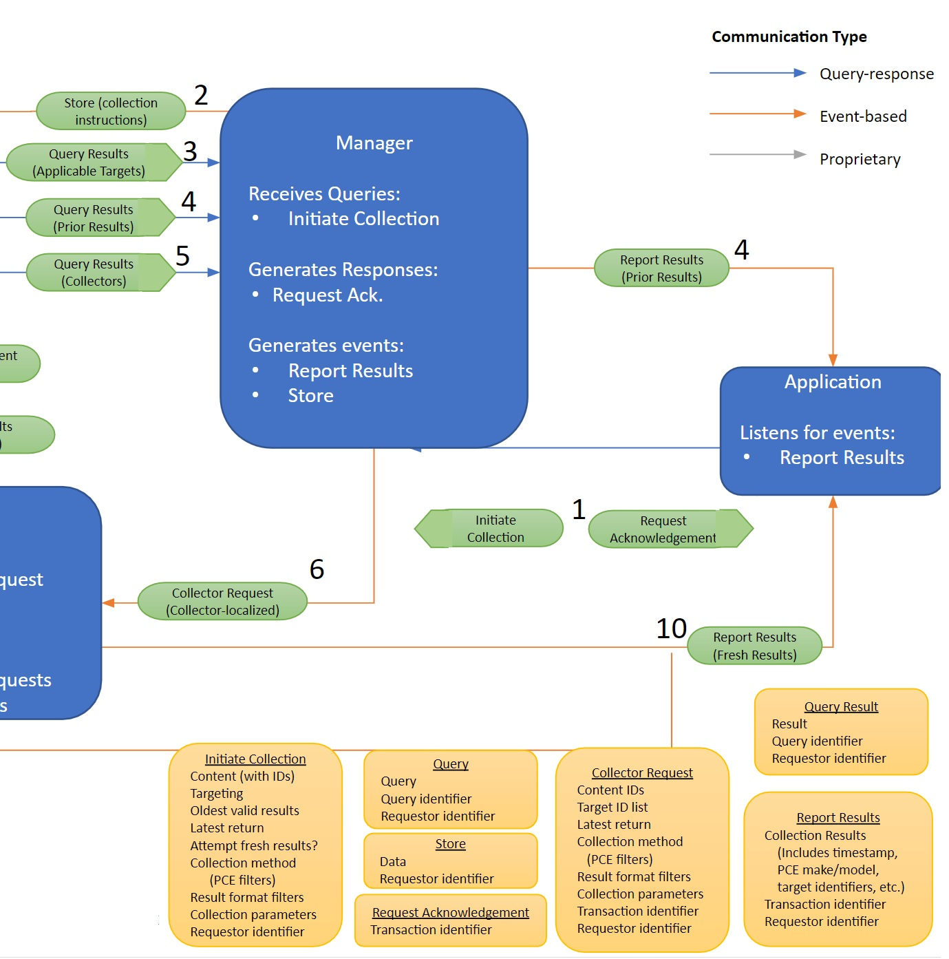
SCAPv2
Data Collection Experiment
or: "How to OpenC2-ize a system spec"
Conceptual Design (messages)
List each Message sent between components
1a. Initiate Collection
1b. Request Acknowledgement
2. Store (collection instructions)
3a. Query (Applicability)
3b. Query Results (Applicable Targets)
Every Message needs a unique name
Message names used by SCAPv2 team ("Initiate Collection") reflect purpose (verb)
Content names ("Assessment-Instructions") refer to data structure (noun)

Slide 8
SCAPv2
Data Collection Experiment
Conceptual Design (messages)
Assign Content name used in each Message
1a. Initiate Collection is a request message with specified content
1b. Request Acknowledgement is a response message, no content
2. Store (collection instructions) shown as event, but may need ack
3a. Query (Applicability) is a request, need content
3b. Query Results (Applicable Targets) is a response, need content
4a. …
For each Message:
* pick an Action(verb) for each request. Target(noun) = name of content
* define content types and attributes
Example: 1a: Initiate Collection message might contain
Action = scan, Target = Assessment-Instructions
Logical Design (attributes)

Slide 9
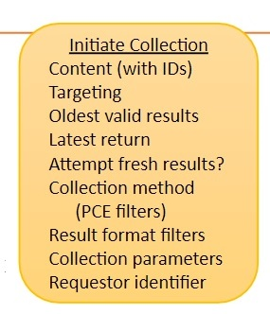
SCAPv2 Actuator Profile
Physical Design (information model with types)
Initiate Collection message:
Target Name: Assessment-Instructions
Target Type: Record (JSON object)
Assessment-Instructions = Record
1 content Assessment-Content
2 targets Assessment-Target [1..*]
3 oldest DateTime
4 latest DateTime
5 refresh Boolean
6 methods PCE-Filter [1..*]
7 formats Result-Format [1..*]
8 params Collection-Parameters
9 requestor Requestor-ID
Assessment-Content = String
Assessment-Target = String
PCE-Filter = String
Result-Format = String
Collection-Parameters = String
Requestor-ID = Binary /uuid
Make up attribute names and types
"Content (with IDs)" is from the system description
"content" is a (made-up) attribute name (could be better)
"Assessment-Content" is a (made-up) type name
"Targeting" sounds vaguely plural, so give it multiplicity [1..*]
"Oldest valid results" sounds like a date-time, but may be more
Create stubs (String) for unknown types
Guess that "Requestor identifier" might be a UUID
Do the same for all Messages
OpenC2 schema for Data Collection Experiment is now defined in sufficient detail for experimenting. Fill in stubs later.
OpenC2 JADN Interface Definition Language

Slide 10
SCAPv2 Actuator Profile
Physical Design (information model with types)
Physical Data Model
(serialized data)
carried in
Initiate Collection Message
Assessment-Instructions = Record
1 content Assessment-Content
2 targets Assessment-Target [1..*]
3 oldest DateTime
4 latest DateTime
5 refresh Boolean
6 methods PCE-Filter [1..*]
7 formats Result-Format [1..*]
8 params Collection-Parameters
9 requestor Requestor-ID
Assessment-Content = String
Assessment-Target = String
PCE-Filter = String
Result-Format = String
Collection-Parameters = String
Requestor-ID = Binary /uuid
Protocol
Message
Content
{
"action": "scan",
"target": {
"scapv2": {
"assessment": {
"content": "foo",
"targets": ["foo", "bar"],
"oldest": "2020-08-23T22:07:48+00:00",
"latest": "2020-09-23T22:07:48+00:00",
"refresh": false,
"formats": ["foo", "bar"],
"params": "a bunch of stuff",
"requestor": "22023fda-6596-45c7-96ac-ab31915a7be1"
}
}
}
}
OpenC2 Command
OpenDXL payload serialized as JSON
OpenC2 JADN Interface Definition Language

Slide 11
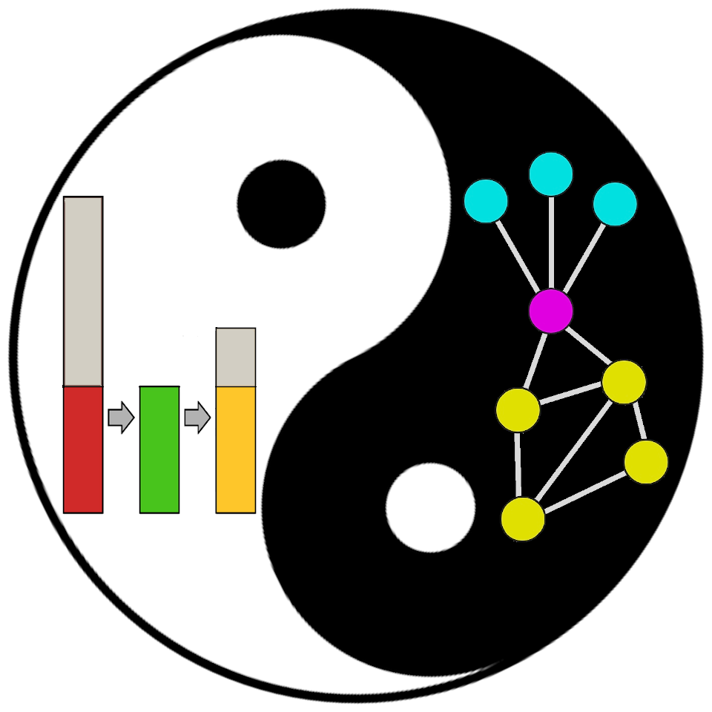
OpenC2 Information Modeling
OpenC2 created the JADN formal information modeling language based on information theory and graph theory.
A package is a namespace for a collection of type definitions
Every type definition is a graph node
Types define the information (entropy) contained in data instances
Serialization rules define data formats used to represent information instances
Graph structure:
Encourages normalization and reuse of named types
Supports evolution from conceptual design to concrete schemas.
An IM is used to both generate specifications and validate data
Improves quality and ensures consistency
IM is a normative definition, not just "a representation of concepts"
An information model is a representation of concepts and the relationships, constraints, rules, and operations to specify data semantics for a chosen domain of discourse.
Information theory studies the quantification, storage, and communication of information.
Graph theory is the study of graphs, which are mathematical structures used to model pairwise relations between objects.
--- Wikipedia
https://github.com/oasis-tcs/openc2-jadn/blob/working/jadn-v1.0-wd01.md

Slide 12
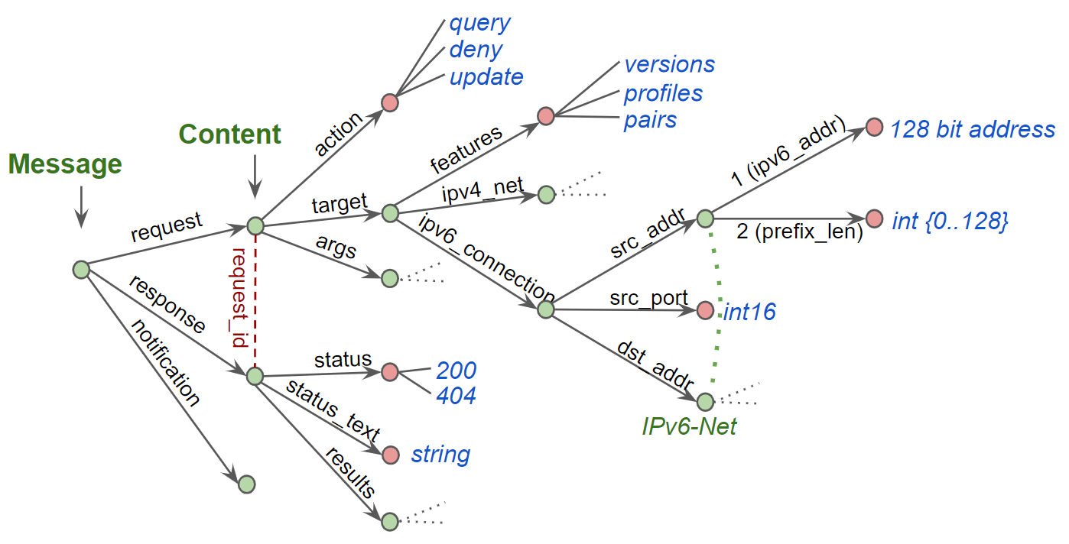
OpenC2 Graph API
Openc2 defines an attribute graph
graph can be denormalized to a directed tree
A graph bound to a protocol is an API
one graph can be bound to multiple protocols
Falcor: "The data is the API":
protocol payload is the entire graph
REST API: graph is split between resource URLs and payload sub-graphs
resource supports only CRUD methods: (POST, GET, PUT, PATCH, DELETE)
graph API supports any noun or verb (request, notification, scan, stop, start, …)
Falcor: https://netflix.github.io/falcor/
GraphQL: https://graphql.org/

Slide 13
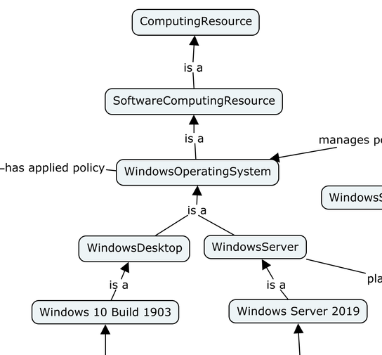
Relationship Modeling
Computing Resource
Software
Computing
Resource
Hardware
Computing
Resource
is a parent of
WindowsOS
LinuxOS
MacOS
has roles
Windows Domain Controller
Windows Server
Windows Desktop
Windows Server 2019
Windows 10 Build 1903
OpenC2 models data relationships as Directed Acyclic Graphs
convert "is a" to "is a parent of" -- identifies alternatives
undirected links support arbitrary relationships among data instances
ComputingResource = Choice
1 sw SoftwareComputingResource
2 hw HardwareComputingResource
WindowsServer = Record
1 version WindowsServerVersion
2 roles WindowsServerRole [1..*]
UML Generalization Sets:
disjoint / overlapping
complete / incomplete
"parent-of" = Choice = disjoint
Goal is to be complete
https://lists.oasis-open-projects.org/g/oca-architecture-wg/message/42
OpenC2 JADN IDL

